Slide 1
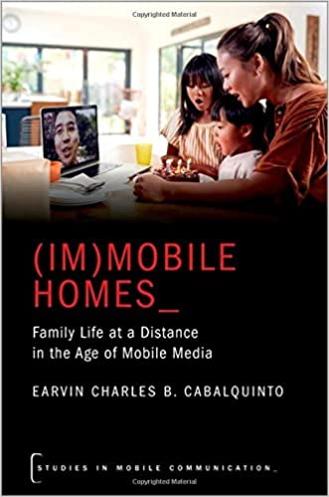
Book presentation webinar
(IM)MOBILE HOMES_
Family Life at a Distance
in the Age of Mobile Media
Speaker
EARVIN CHARLES B. CABALQUINTO
ARC DECRA Research Fellow & Senior Lecturer at Monash University
Chair
Eralba Cela
University of Milan
Discussant
Paolo Boccagni
University of Trento
15 May 2023
10 am CET

